Slide 1

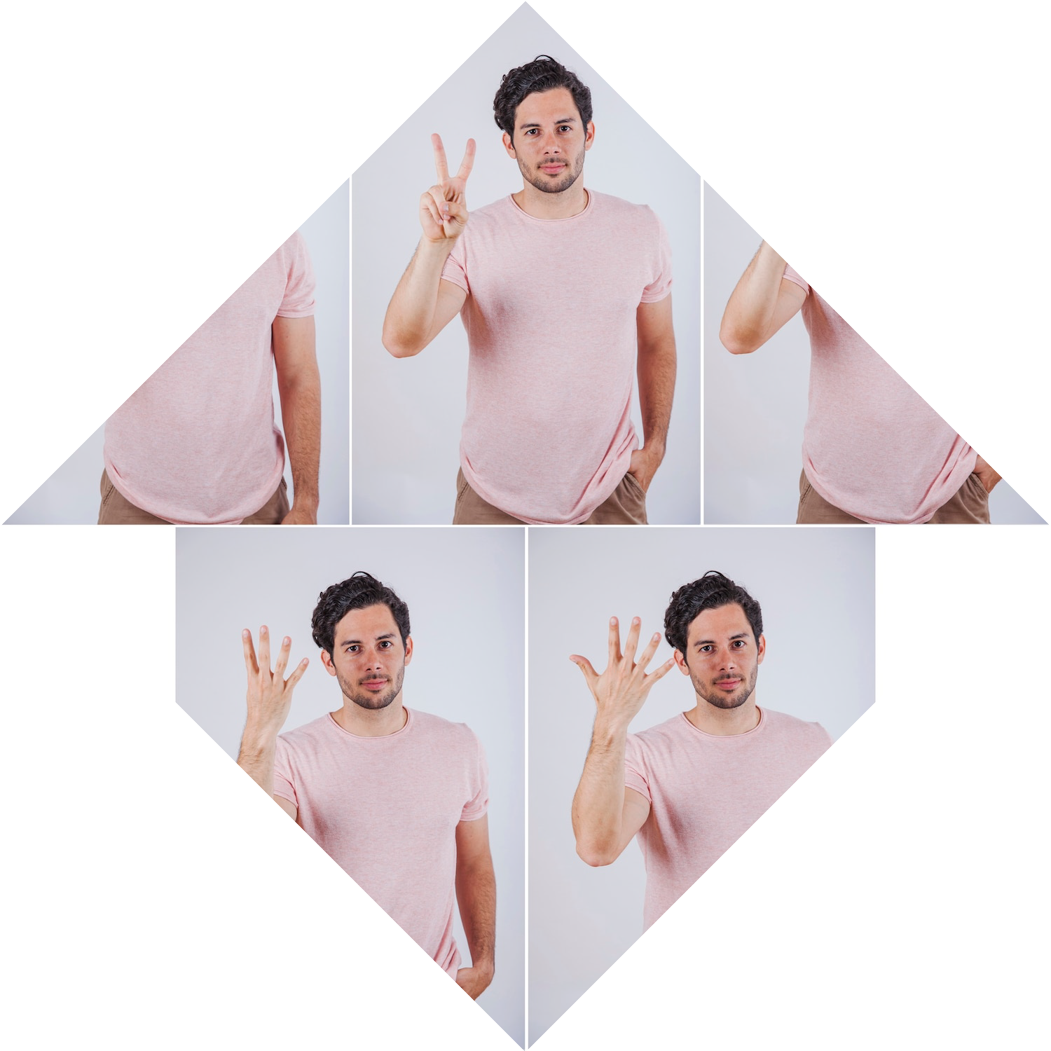
DEEP LEARNING FOR FACIAL RECOGNITION AND EMOTION DETECTION

Slide 2

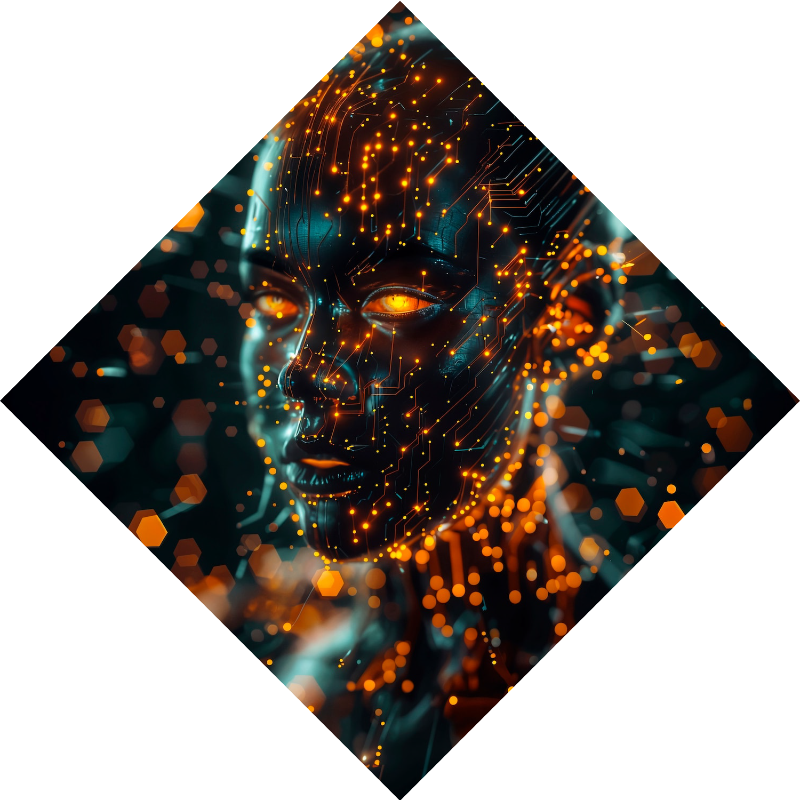



Introduction to Deep
Learning
Deep Learning has revolutionized
with its ability to learn from vast amounts of data. This presentation explores how these techniques are applied in
and
, providing insights into their potential and challenges.

Slide 3






Understanding Facial Recognition
Facial recognition technology utilizes algorithms to identify and verify
individuals based on their facial features. It
involves and
, enabling accurate identiﬁcation across various environments.

Slide 4
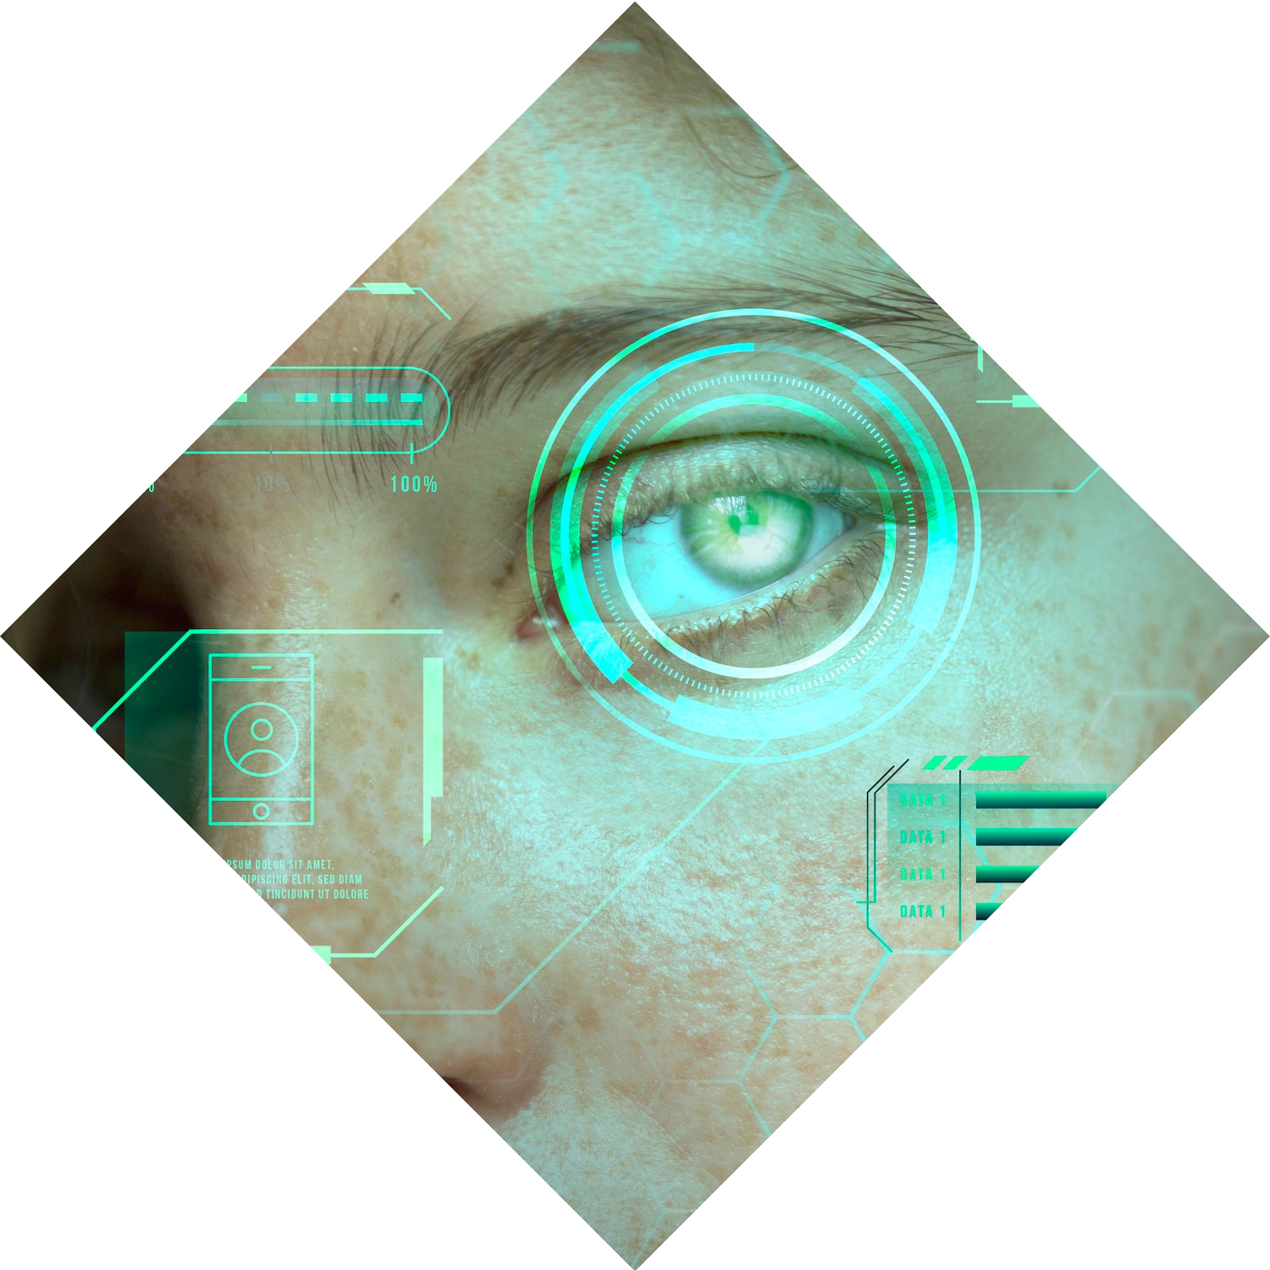





Key Deep Learning Techniques
Common techniques in facial recognition include
and
. These methods enhance the
model's ability to recognize faces under diﬀerent conditions, improving both and .

Slide 5






Emotion Detection Overview
Emotion detection analyzes facial expressions to interpret human
emotions. By leveraging
, systems can classify emotions such as ,
, and , facilitating
applications in customer service and
mental health.

Slide 6
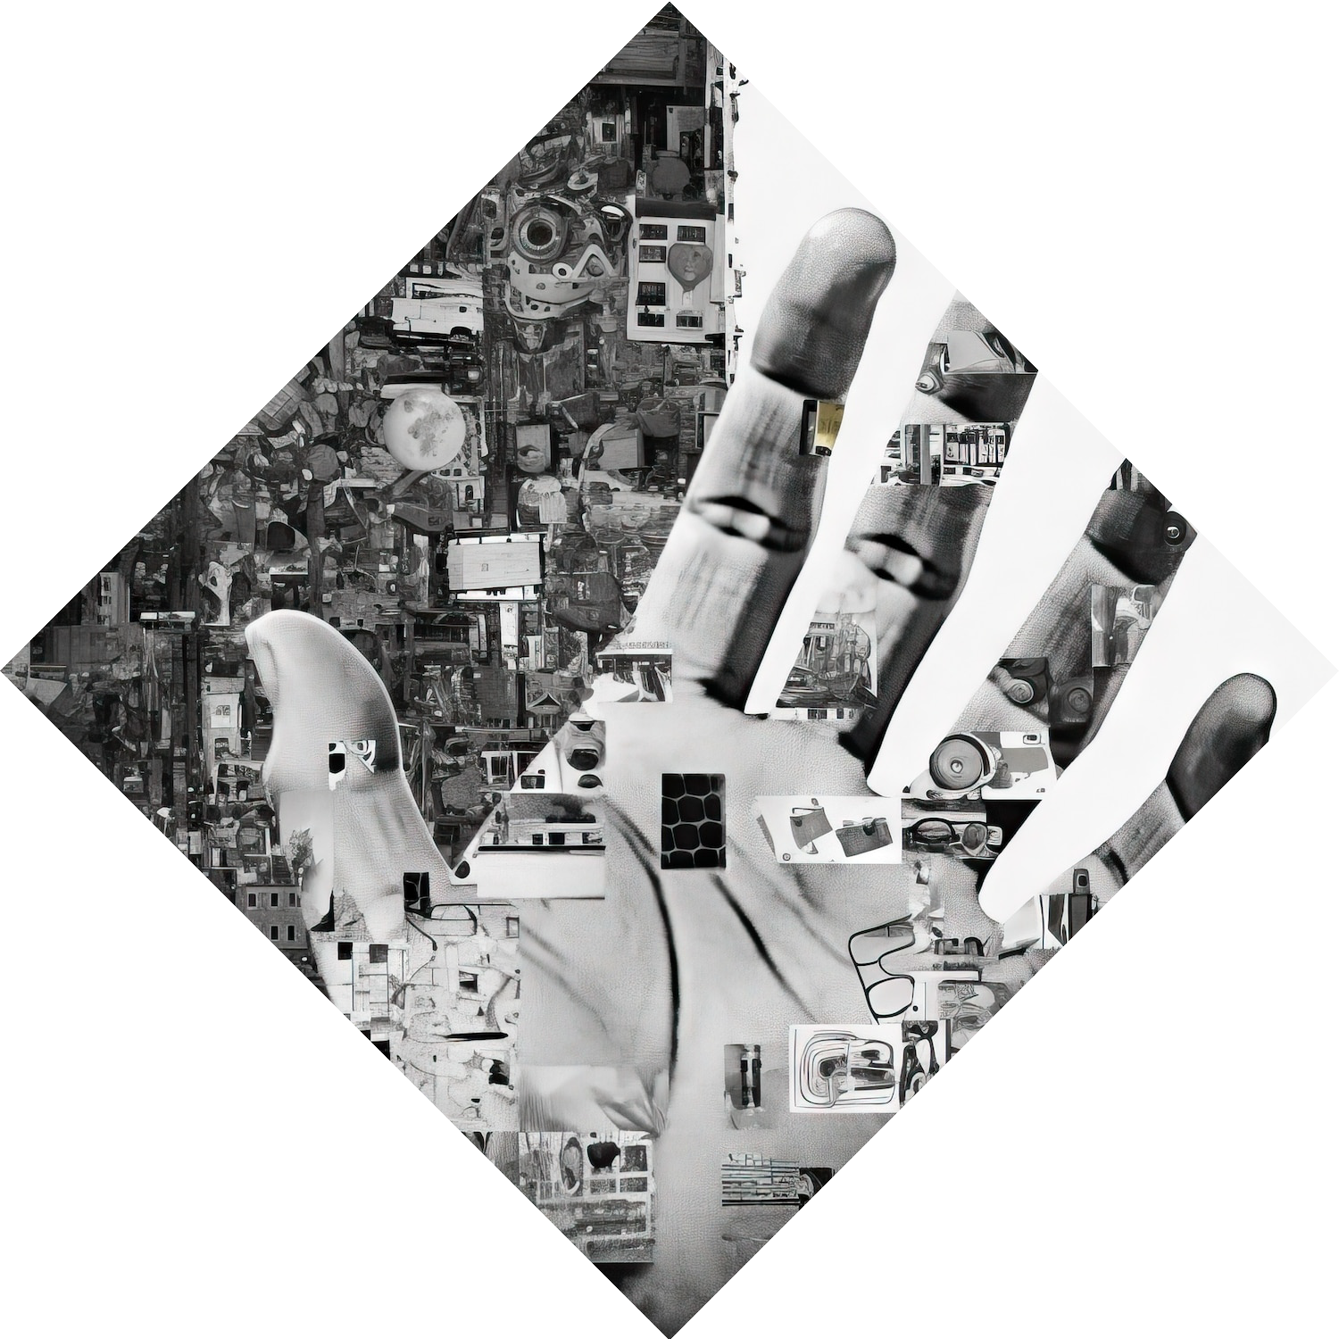
WORK DONE TO DATE
1.Data Collection and Preprocessing
2.Model Architecture
3.Training and Validation

Slide 7
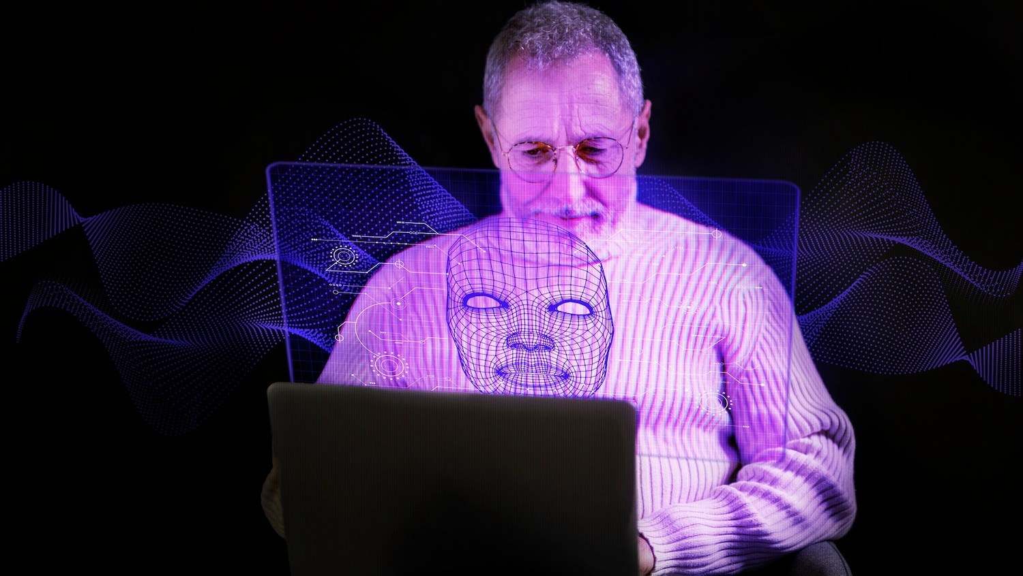
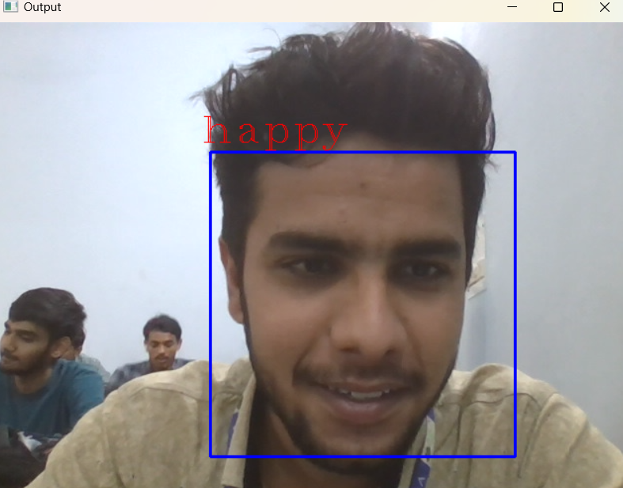
SNAPSHOT OF OUTPUT

Slide 8
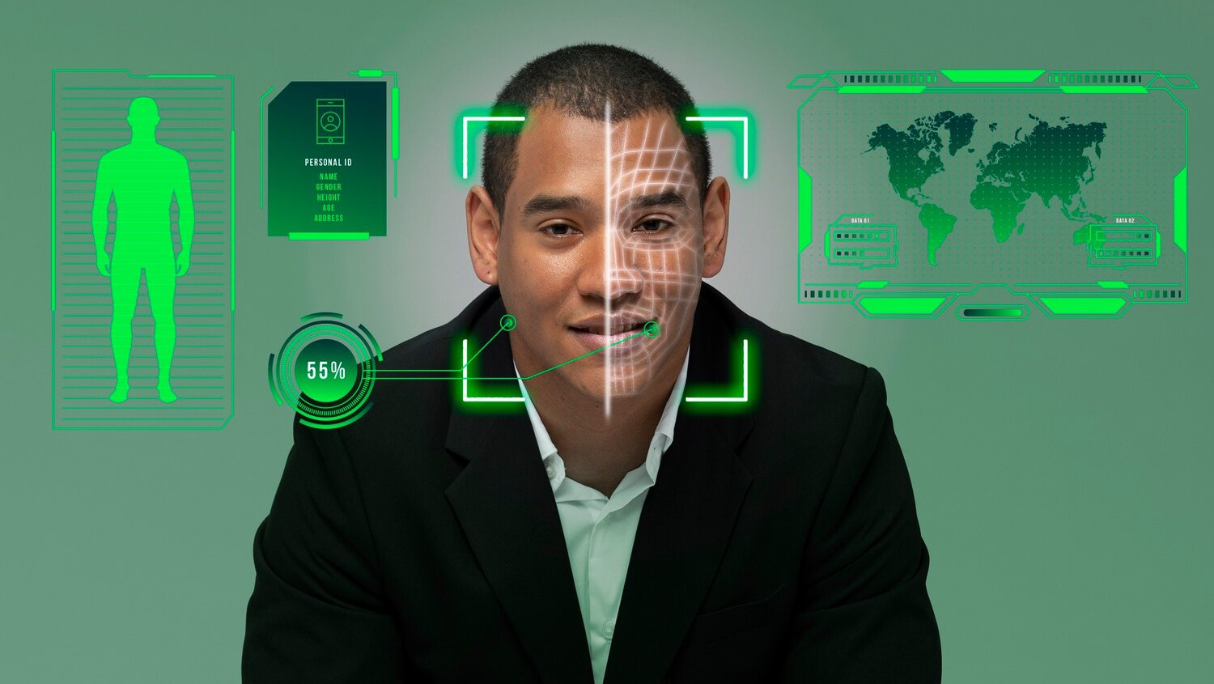
FUTURE PLANS FOR NEXT MONTH
Model Refinement
Real Time Implementation
User Interface Development
Feedback and Testing

Slide 9
Conclusion and Insights
In conclusion, leveraging deep learning for facial recognition and emotion detection oﬀers signiﬁcant potential for various sectors.
However, addressing ethical challenges is essential for responsible implementation and
trust in these technologies.

Slide 10
Thanks!

